Slide 1
Quick Sort

Slide 2
Quick Sort
Explanation of Quick Sort
Visualization of Quick Sort
Implementation of Quick Sort

Slide 3
Quick Sort
The quick sort uses divide and conquer to gain the same advantages as the merge sort, while not using additional storage.
As a trade-off, however, it is possible that the list may not be divided in half.
When this happens, we will see that performance is diminished.

Slide 4
Quick Sort
A quick sort first selects a value, which is called the pivot value.
The role of the pivot value is to assist with splitting the list.
The actual position where the pivot value belongs in the final sorted list, commonly called the split point, will be used to divide the list for subsequent calls to the quick sort.

Slide 5

Quick Sort
54 is out first pivot value.

Slide 6
Quick Sort
The partition process will happen next.
It will find the split point and at the same time move other items to the appropriate side of the list, either less than or greater than the pivot value.

Slide 7
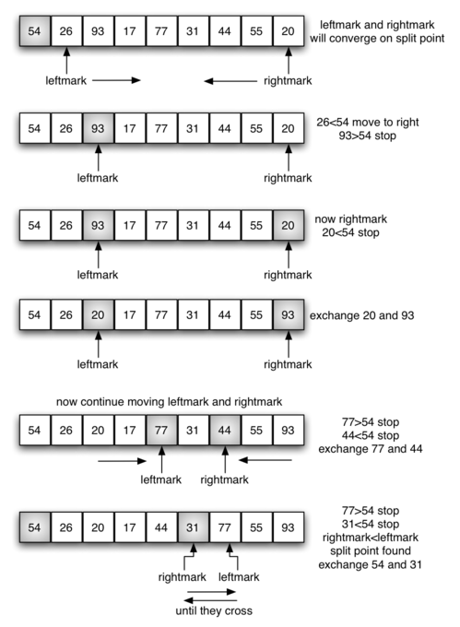
Quick Sort

Slide 8
Quick Sort

Slide 9
Quick Sort

Slide 10
Visualizations
Let’s take a look at some visualizations!

